Slide 1


Midterm project presentation
Loan Default Dataset Analysis
GitHub repository:
https://github.com/Bail111/Loan_Default-Analysis.git
REPORTER：Qinjunjie Pu
October 25th

Slide 2
I
01
troduction

Slide 3


Introduction
This project aims to predict whether a loan will default.
Minimizing financial losses
Classification problem
Data Source:
Data Collection: past data on the loan borrowers

Slide 4
E
02
xploratory Data Analysis

Slide 5
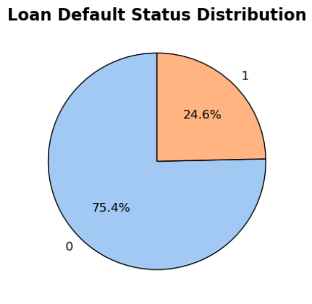
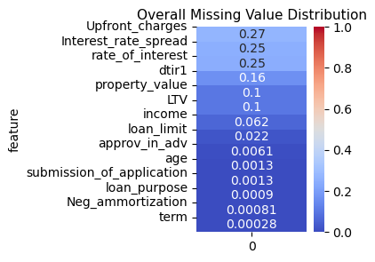
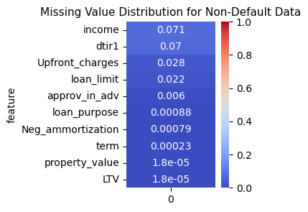
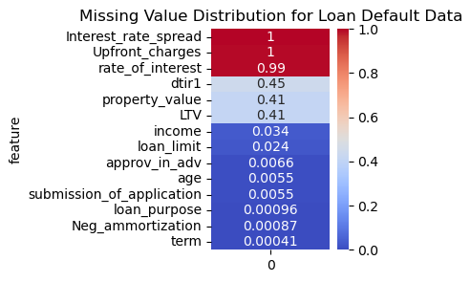
EDA
Brief description of dataset
row: 148670
col: 34
12 continuous features
21 categorical features

Slide 6
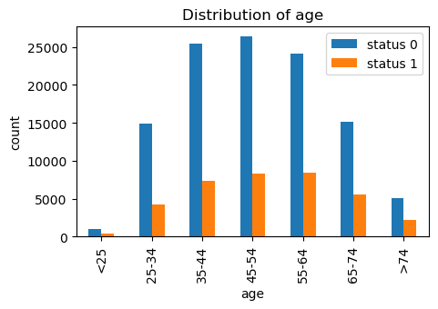
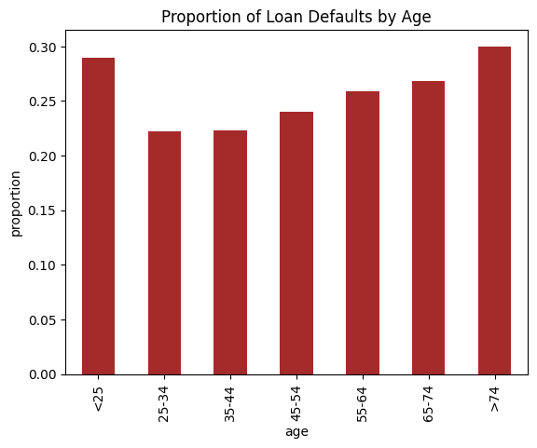
EDA
Analysis for categorical features
age: the age of the applicant

Slide 7
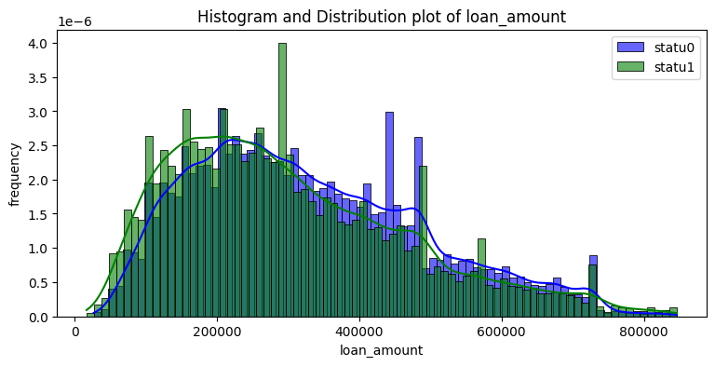
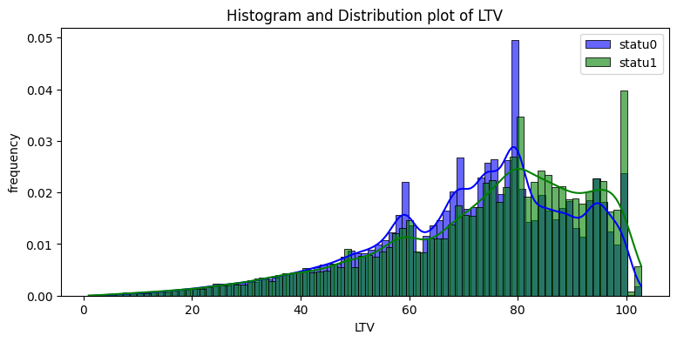
EDA
Analysis for continuous features
loan_amount: amount of money being borrowed
LTV: | loan-to-value ratio, calculated as the loan amount divided by the property value

Slide 8
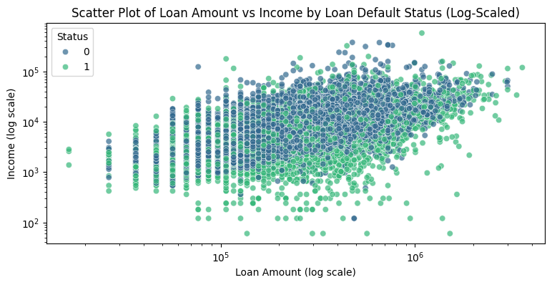
EDA
Analysis for continuous features
Income: | applicant's annual income
loan_amount: | amount of money being borrowed

Slide 9
S
03
plitting and
preprocessing

Slide 10

Splitting and preprocessing
Splitting method
Sratified split to 20% test set
Loan default Dataset
80% other data
Using StratifiedKFold to perform 10-fold cross-validation on training and validation set

Slide 11
Splitting and preprocessing
ID, year (2019 for all data)
Preprocessing
Delete features
2. For categorical features:
Binary label encoding
Ordinal encoding
Onehot encoding
3. Standard scalar for all features
Impute missing value with ‘missing’
e.g. business_or_commercial (‘nob/c’ to 0, ‘b/c’ to 1)
e.g. age ('<25’, '25-34’, '35-44’, etc.)
e.g. region
Before preprocessing: 33 features
After preprocessing: 53 features
Both with 148670 data points

Slide 12
T
end
hanks for listening

